Slide 1

Prepared by Logical Operators
for COSC 3F00
April 3rd, 2014

Slide 2
Review
Using Agile principles
Split project into time-boxed iterations
Created and prioritized the list of features
Pulled highest priority features into the current iteration

Slide 3
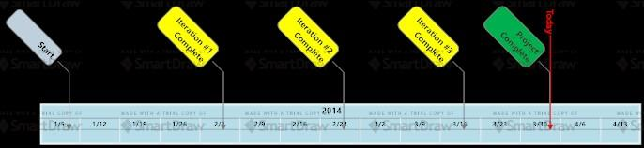
Project Timeline

Slide 4
Iteration #4 Goals
Pulled the next set of features from the backlog
Implementation of the hardest level of artificial intelligence
Sound
Online play

Slide 5
Planning
Final iteration was limited to 2 weeks
All tasks are tracked in GitHub
Analysis, design, construction and testing spawned many subtasks eventually leading to a total of 26 project tasks

Slide 6
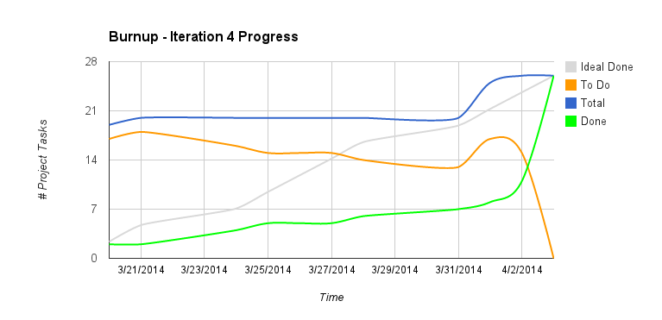

Slide 7
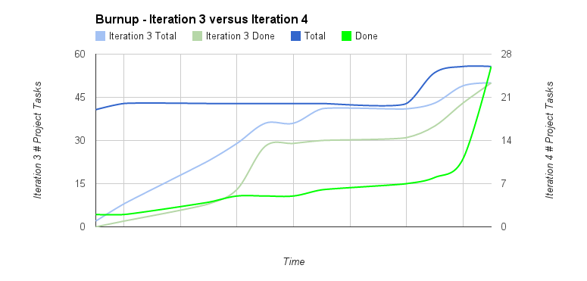

Slide 8
Observations
The shorter duration was challenging
Several relatively complex components (web server, database, integration with Google services) took more time than predicted

Slide 9
Continuing Other Iteration Activities
GitHub used to house all artifacts, source code and automated tests
Analysis and design artifacts followed conventions from previous iterations
Construction and testing was done using AndroidStudio
travis-ci.org used for continous integration

Slide 10
Reflection
Agile Principle #12:
“At regular intervals, the team reflects on how to become more effective, then tunes and adjusts its behavior accordingly.”
Source: agilemanifesto.org/principles.html

Slide 11
Demonstration

Slide 12
Feedback?
Q&A

Slide 13
Thank you

